Slide 1
Exercise-Related Smart-Device Market Trends
BellaBeat Case Study
Adam Raabe
Updated: 6/18/2025

Slide 2
Problem Statement
Our products are part of the smart-device market. As this market grows, our products have opportunities to grow as well.
How can we capitalize on trends within the market to expand the potential reach of our products?
Notes:
Focus on: BellaBeat Spring

Slide 3
Executive Summary
Focusing marketing efforts for key demographics on specific facts can link consumer experience to product benefit, increasing ROI:
Exercise rates are highest on Mondays, Wednesdays, and Saturdays.
Exercise rates peak at 7pm, 5-10% higher than other peaks, and 77% higher than the average rate. This is especially pronounced on work-week days.
Peak CTR for our primary demographic is 7-10% higher in the mornings than in the next highest timeframe, but for older consumers the peak time skews later.
Expanding marketing techniques to focus on other advertisement pathways can reach underutilized browsing time:
Our primary demographic has the highest CTR (39%) while intentionally shopping. Current marketing techniques already cover this browsing time.
Our primary demographic has the second highest CTR (38%) during the consumption of entertainment content. This browsing category can be addressed by sponsoring social media influencers.
Notes:
CTR = Click through rate, how often advertisements are clicked on
Peak CTRs are calculated from general advertising datasets, not internal ones specifically for our products
For our product focus: BellaBeat Spring is likely to appeal more to thirsty consumers who are practicing or finishing their exercise routines. Additionally, having influencers explain the benefits of BellaBeat Spring will get users interested in the benefits the product provides, as well as associating it with healthier individuals.

Slide 4
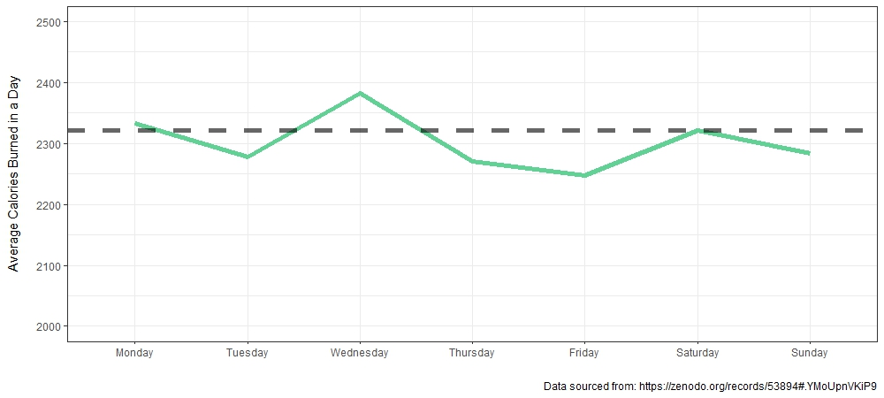
Exercise rates are highest on Mondays, Wednesdays, and Saturdays, so focusing marketing efforts on those days should lead to the highest ROI.
Notes:
Friday reports the least average exercise of any day of the week.

Slide 5
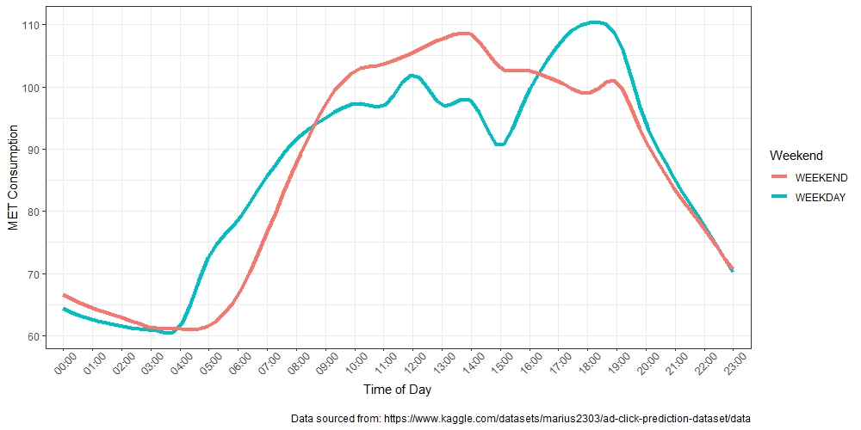
Overall, exercise rates peak at 6-7pm, although the effect is primarily caused by the work week.
Notes:
METs => Metabolic Equivalent of a Task
METs are a method of measuring the intensity of activities. 1 MET is the roughly equivalent to the energy expenditure of sitting quietly for a minute.

Slide 6
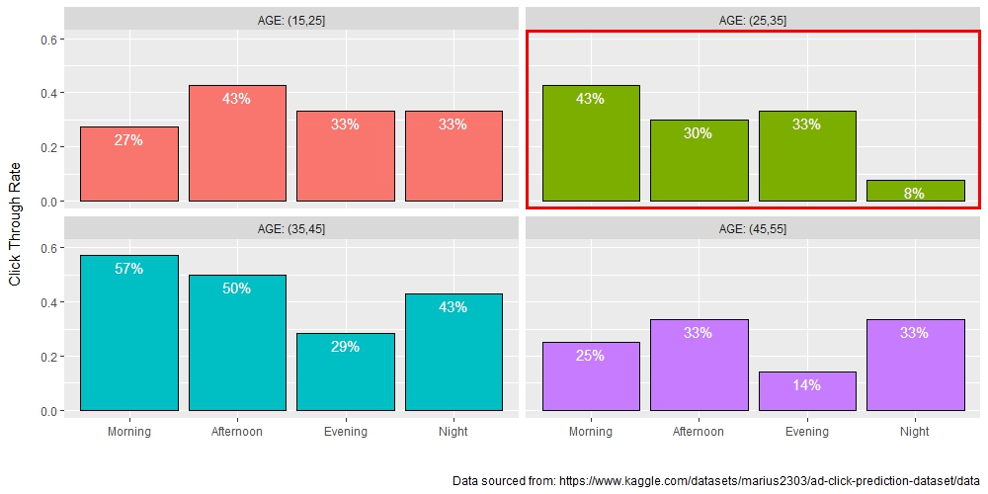
However, for our target demographic, CTR is highest in the morning.
Notes:
These two things can be reconciled by showing advertisements to consumers in the evening, but having them click through in the morning.

Slide 7
Potential Unification of these Facts
Advertisements could be multipurpose:
Focus evening efforts on raising product awareness through longer and fuller advertisements.
Focus morning efforts on creating click opportunities by using an abridging version of the advertisement.
Follow-up Research Needed:
Consider ROI of the creation of multiple advertisement versions.
Generate data to check the connection between thirst and desire to purchase BellaBeat Spring.
Update CTR data to be specific to our products.

Slide 8
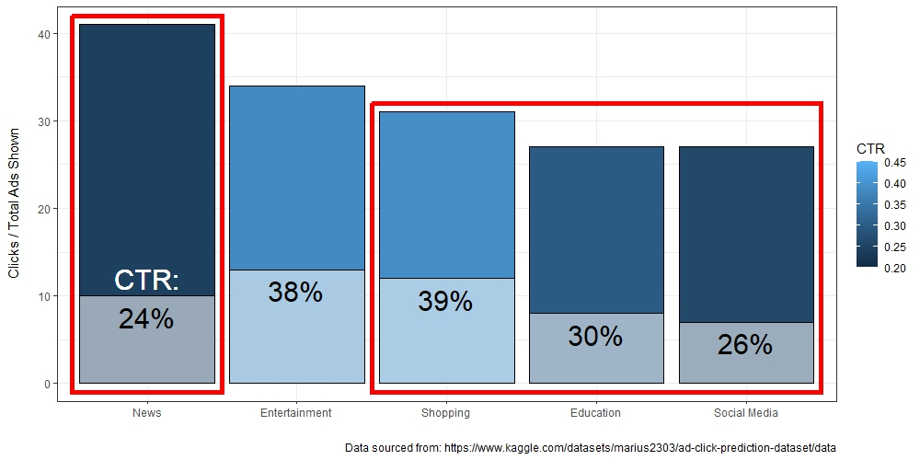
Advertisements through Google Display Network fit with the structure of most categories.
Notes:
This data is specifically from female respondents.

Slide 9
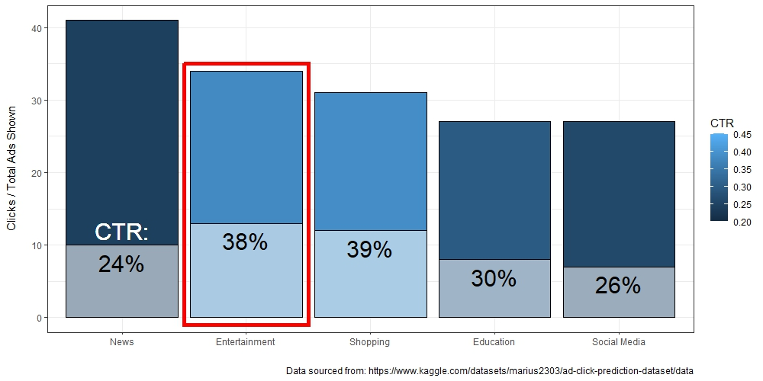
However, our current marketing strategy does not capitalize on the strengths of the entertainment category.
Notes:
This data is specifically from female respondents.

Slide 10
Potential Improvements
Follow-up Research Needed:
Consideration of the ROI of sponsorships over the existing strategy
Identification of influencers who have similar values to company culture
Methods of increasing the CTR for high-impact but low-utilization categories (News)
Continue the use of Google Display Network advertising.
Reach out to key social media influencers with sponsorships to increase visibility of our products and their benefits.
Creation of programs and/or challenges to boost engagement with the data aspects of our products.

